Slide 1



Consuming a RESTful API
Mark J. Buckler
OCPJP,CIWJS

Slide 2

Credits
Some of the contents of this slide presentation have been referenced and reproduced, from RESTful Web API Design with Node.js, by Saleh Hamadeh, ©2017 LinkedIn Corporation.
Additional content has been referenced and reproduced, from Understanding REST, by Michael Sullivan, ©2017 LinkedIn Corporation.

Slide 3
LEARNING OBJECTIVES
Authentication and Authorization
Consuming Twitter’s REST APIs

Slide 4
Authentication and Authorization
The OAuth 1.0a Standard
OAuth is an open standard for interacting with protected data
Allows one application to access another application’s data
On behalf of a user, without asking for the user’s password
Uses
Sharing data between services
Enables signing in using other services

Slide 5
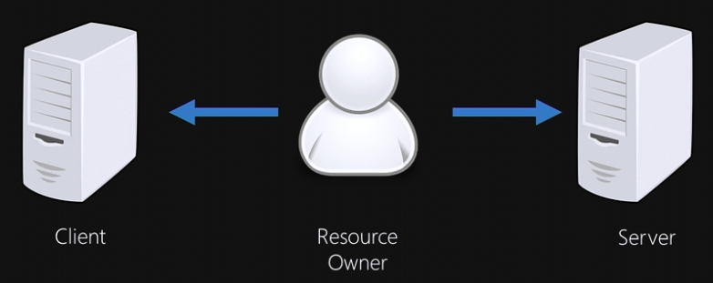
Authentication and Authorization
Parties Involved in OAuth
Client: an HTTP client that can make authenticated requests
The Node/Express application we are building will be the OAuth client
Server: an HTTP server that can accept authenticated requests
Twitter will be the OAuth server for our application
Resource Owner: Twitter app we built and own under our login and password

Slide 6
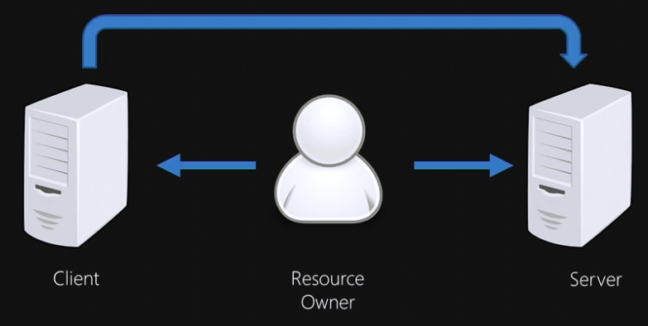
Authentication and Authorization
Parties Involved in OAuth
Before the client is authenticated, the Resource Owner should be able to access the client and the server
After authentication, client can access the protected resources on the server on behalf of the user – the Twitter data

Slide 7
Authentication and Authorization
OAuth Flow – 3 Main Steps
Client asks for a request token
Client includes its consumer or API key and a consumer secret
Also includes a callback URL, server will use it later on
If verified, server sends back request token and a secret key
Get temporary credentials
Client goes to authentication URL, including request token, and is asked to log in
If verified server redirects user to callback URL, grants temporary token and a secret
Client exchanges temporary credentials for access token
Can use access token to access protected resources

Slide 8
Authentication and Authorization
Creating an OAuth Login Request
We will build some modularized code to handle the task
Install the dependencies we will need with NPM
Create a configuration file
For our configuration, URLs, and various access keys
Modify our Node /Express server to handle the routing
Routing is the term for our various endpoint functions
This will be the authentication flow
Build an authentication module
This will handle the OAuth workload

Slide 9

Authentication and Authorization
Programming Exercise02_02_01 – Step 1
Creating an OAuth Login Request
Install Dependencies and Build a Configuration File

Slide 10
Authentication and Authorization
ExpressJS Routing https://expressjs.com/en/guide/routing.html
Routing refers to the definition of application end points (URIs) and how they respond to client requests
A route method is derived from one of the HTTP verbs
It is attached to an instance of the express class
app.get(URL, callback(req, res){ // stuff to do });

Slide 11
Authentication and Authorization
ExpressJS Middleware https://expressjs.com/en/guide/writing-middleware.html
Middleware functions are functions that have access to the request object (req), the response object (res), and the next function in the application’s request-response cycle
The next() function is a function in the Express router which, when invoked, executes the middleware succeeding the current middleware

Slide 12
Authentication and Authorization
ExpressJS Middleware
Middleware functions can perform the following tasks
Execute any code
Make changes to the request and the response objects
End the request-response cycle
Call the next middleware in the stack

Slide 13
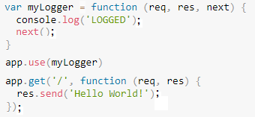
Authentication and Authorization
ExpressJS Middleware
To load a middleware function employ app.use([path,] callback[, callback]);

Slide 14
Authentication and Authorization
Programming Exercise02_02_01 – Step 2
Creating an OAuth Login Request
Establish the ExpressJS Routing and Middleware
Obtain an Oauth Access Token and Secret

Slide 15
Authentication and Authorization
Ngrok
A third-party application used to expose local servers behind a NAT to the public internet over secure tunnels
NAT: Network Address Translation, remaps one IP address into another by modifying address information
Run ngrok and provide it the port of a listening network service, usually a web server
Connects to the ngrok cloud service
Accepts traffic on a public address
Relays that traffic through to the ngrok process running on the local machine, then on to the local specified address

Slide 16
Authentication and Authorization
Programming Exercise02_02_01 – Step 3
Creating an OAuth Login Request
Establish a Secure Internet Tunnel to Localhost
Use the OAuth Callback to Authenticate the User

Slide 17
Authentication and Authorization
Programming Exercise02_02_01 – Step 4
Use the Access Token to Obtain the User’s Twitter ID

Slide 18
Consuming Twitter’s REST APIs
Twitter REST APIs https://developer.twitter.com/en.html#
Go to the Docs Documentation and bring up Basics for study
Particularly look at Rate Limits
15-minute intervals with a maximum number of requests, usually 15 requests, avoid being blacklisted
Go to the Docs API Reference Index and scroll through
All of the API endpoints are implemented for GET or POST
GET is for use of collections, safe
POST is to make use of procedures, unsafe

Slide 19
Consuming Twitter’s REST APIs
Programming Exercise02_02_01 – Step 5
Consuming Twitter’s REST APIs
Construct Generic GET and POST Functions
Build a Route to Use the Twitter REST APIs to Tweet

Slide 20
Consuming Twitter’s REST APIs
Programming Exercise02_02_01 – Step 6
Consuming Twitter’s REST APIs
Build a Route to Search for Tweets

Slide 21
Consuming Twitter’s REST APIs
Twitter Cursored Collections
Twitter uses cursored collections where the returned results may be very large
This means that the results will be returned in groups, or “pages”
A cursor, or pointer, is set with each return to indicate the starting point of the next “page” of data
In some collections, a previous_cursor and next_cursor is provided
Enables paging back and forth in the data
-1 is beginning of the collection, 0 is the end

Slide 22
Consuming Twitter’s REST APIs
Programming Exercise02_02_01 – Step 7
Consuming Twitter’s REST APIs
Build a Route to Search for Friends

Slide 23
Consuming Twitter’s REST APIs
Asynch.js
As we have seen, it is not always possible to get all the data we want in one request
Manually copying a cursor value to a URL bar is not a great solution other than for debugging
Async module provides straight-forward, powerful functions for working with asynchronous JavaScript
Includes some common patterns for asynchronous control flow: parallel, series, waterfall
We can use the concept of a waterfall function to help us traverse the collections with multiple API calls

Slide 24

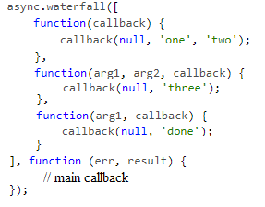
Consuming Twitter’s REST APIs
Asynch.js Waterfall
Runs the tasks array of functions in series
Each function has its own callback
Each task passes its results to the next task in the array
The optional callback after the array may be run once all tasks have completed
If any task passes an error to its own callback, the next function is not executed, and the main callback is immediately called with the error

Slide 25
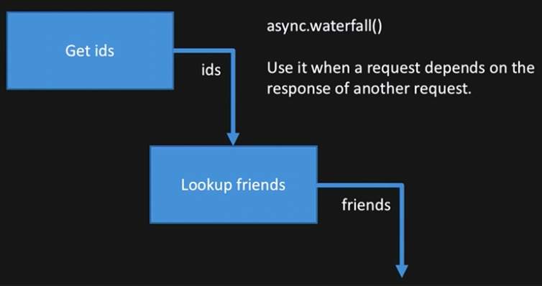
Consuming Twitter’s REST APIs
Asynch.js Waterfall

Slide 26
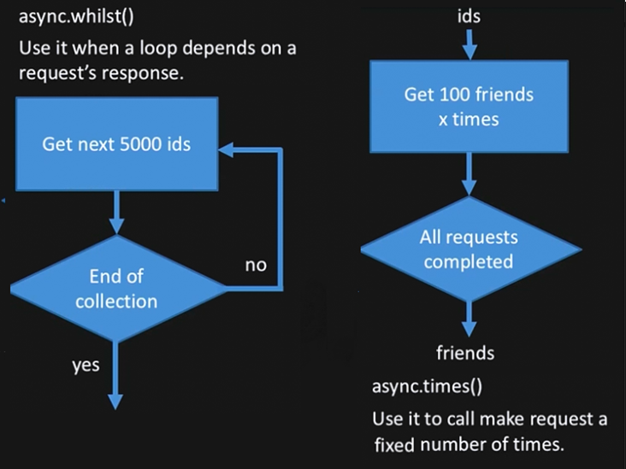
Consuming Twitter’s REST APIs
Asynch.js Waterfall

Slide 27
Consuming Twitter’s REST APIs
Programming Exercise02_02_01 – Step 8
Consuming Twitter’s REST APIs
Build an Asynchronous Handler to Search for All Friends

